Slide 1
Welcome to the experiment.
Please get out a pen/pencil and a piece of paper. In this experiment, you will answer Yes/No questions about a series of words. You will see each question appear for two seconds, then a “target” word will appear for one second. You will have five seconds to record your answer. After that, a click will sound as the next question appears.
When you are ready, the experimenter will show you an example trial.

Slide 2
Example
Is the word found in the sky?

Slide 3
clouds
(Write Yes or No on your sheet.)

Slide 5
Very good. If you have any questions, please ask them now.
Number your paper 1-60. When you are ready, the experiment will begin.

Slide 6
1. Is the word found in the garden?

Slide 7
1. FLOUR

Slide 9
2. Does the word rhyme with pearl?

Slide 10
2. earl

Slide 12
3. Does the word rhyme with coach?

Slide 13
3. roach

Slide 15
4. Does the word rhyme with pain?

Slide 16
4. juice

Slide 18
5. Is the word in capital letters?

Slide 19
5. lane

Slide 21
6. Does the word rhyme with claim?

Slide 22
6. FLAME

Slide 24
7. Does the word rhyme with shake?

Slide 25
7. BOAT

Slide 27
8. Is the word a part of the body?

Slide 28
8. CHEEK

Slide 30
9. Is the word a type of farm animal?

Slide 31
9. sheep

Slide 33
10. Is the word associated with magic?

Slide 34
10. SINGER

Slide 36
11. Is the word in capital letters?

Slide 37
11. TWIG

Slide 39
12. Is the word in capital letters?

Slide 40
12. copper

Slide 42
13. Is the word in capital letters?

Slide 43
13. witch

Slide 45
14. Is the word in capital letters?

Slide 46
14. trout

Slide 48
15. Does the word rhyme with school?

Slide 49
15. dance

Slide 51
16. Is the word a type of vehicle?

Slide 52
16. CART

Slide 54
17. Is the word a type of container?

Slide 55
17. PAIL

Slide 57
18. Is the word a type of precious stone?

Slide 58
18. JADE

Slide 60
19. Does the word rhyme with trunk?

Slide 61
19. knife

Slide 63
20. Is the word used for cleaning?

Slide 64
20. lark

Slide 66
21. Is the word a mode of travel?

Slide 67
21. brake

Slide 69
22. Does the word rhyme with shove?

Slide 70
22. glove

Slide 72
23. Is the word in capital letters?

Slide 73
23. STATE

Slide 75
24. Does the word rhyme with clobber?

Slide 76
24. ROBBER

Slide 78
25. Is the word a type of metal?

Slide 79
25. TIRE

Slide 81
26. Is the word in capital letters?

Slide 82
26. floor

Slide 84
27. Is the word in capital letters?

Slide 85
27. BEAR

Slide 87
28. Does the word rhyme with pull?

Slide 88
28. lamp

Slide 90
29. Is the word in capital letters?

Slide 91
29. CLIP

Slide 93
30. Is the word in capital letters?

Slide 94
30. clove

Slide 96
31. Is the word a type of occupation?

Slide 97
31. MAST

Slide 99
32. Is the word in capital letters?

Slide 100
32. rock

Slide 102
33. Is the word in capital letters?

Slide 103
33. CHILD

Slide 105
34. Does the word rhyme with park?

Slide 106
34. BRUSH

Slide 108
35. Does the word rhyme with rove?

Slide 109
35. GRIN

Slide 111
36. Is the word a type of weapon?

Slide 112
36. monk

Slide 114
37. Is the word a type of toiletry?

Slide 115
37. tribe

Slide 117
38. Does the word rhyme with scribe?

Slide 118
38. SOAP

Slide 120
39. Does the word rhyme with dice?

Slide 121
39. RICE

Slide 123
40. Is the word a written form of art?

Slide 124
40. sonnet

Slide 126
41. Does the word rhyme with past?

Slide 127
41. MINER

Slide 129
42. Does the word rhyme with sore?

Slide 130
42. chapel

Slide 132
43. Does the word rhyme with curse?

Slide 133
43. nurse

Slide 135
44. Is the word found in the countryside?

Slide 136
44. field

Slide 138
45. Does the word rhyme with raw?

Slide 139
45. CLAW

Slide 141
46. Is the word a type of implement?

Slide 142
46. DRILL

Slide 144
47. Is the word in capital letters?

Slide 145
47. FIDDLE

Slide 147
48. Is the word in capital letters?

Slide 148
48. fence

Slide 150
49. Is the word in capital letters?

Slide 151
49. DAISY

Slide 153
50. Is the word a type of furniture?

Slide 154
50. WOOL

Slide 156
51. Is the word in capital letters?

Slide 157
51. moan

Slide 159
52. Is the word a type of physical activity?

Slide 160
52. pool

Slide 162
53. Does the word rhyme with pass?

Slide 163
53. glass

Slide 165
54. Is the word in capital letters?

Slide 166
54. SPEECH

Slide 168
55. Does the word rhyme with tram?

Slide 169
55. GRAM

Slide 171
56. Is the word in capital letters?

Slide 172
56. WEEK

Slide 174
57. Is the word a body of water?

Slide 175
57. pond

Slide 177
58. Is the word a type of fruit?

Slide 178
58. cherry

Slide 180
59. Is the word in capital letters?

Slide 181
59. sleet

Slide 183
60. Is the word in capital letters?

Slide 184
60. HONEY

Slide 186
Memory Test
The first part of the experiment is over. Now, there will be a memory test.
Turn over your piece of paper and write down as many “target” words as you can recall from the first part of the experiment. You have five minutes, starting now.

Slide 187
Well done.
The experiment is now over. Feel free to take a quick break.
Next, you will calculate your performance and be debriefed.

Slide 188
Count how many of the following words you recalled:
lane, copper, witch, trout, floor, clove, rock, fence, moan, sleet, twig, state, bear, clip, child, fiddle, daisy, speech, week, honey.
  Label this number “Case.”
juice, boat, dance, knife, lamp, brush, grin, soap, miner, chapel, earl, roach, flame, glove, robber, rice, nurse, claw, glass, gram
  Label this number “Rhyme”
Flour, singer, lark, brake, tire, mast, monk, tribe, wool, pool, cheek, sheep, cart, pail, jade, sonnet, field, drill, pond, cherry
  Label this number “Category”

Slide 189
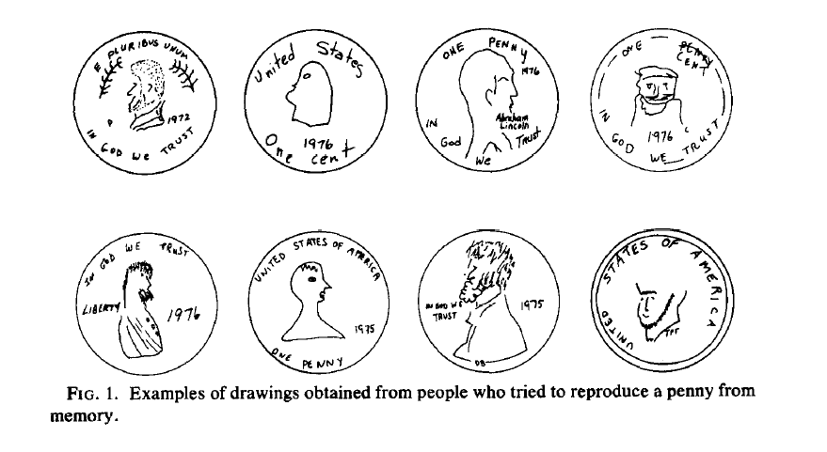
Nickerson & Adams, 1979

Slide 190
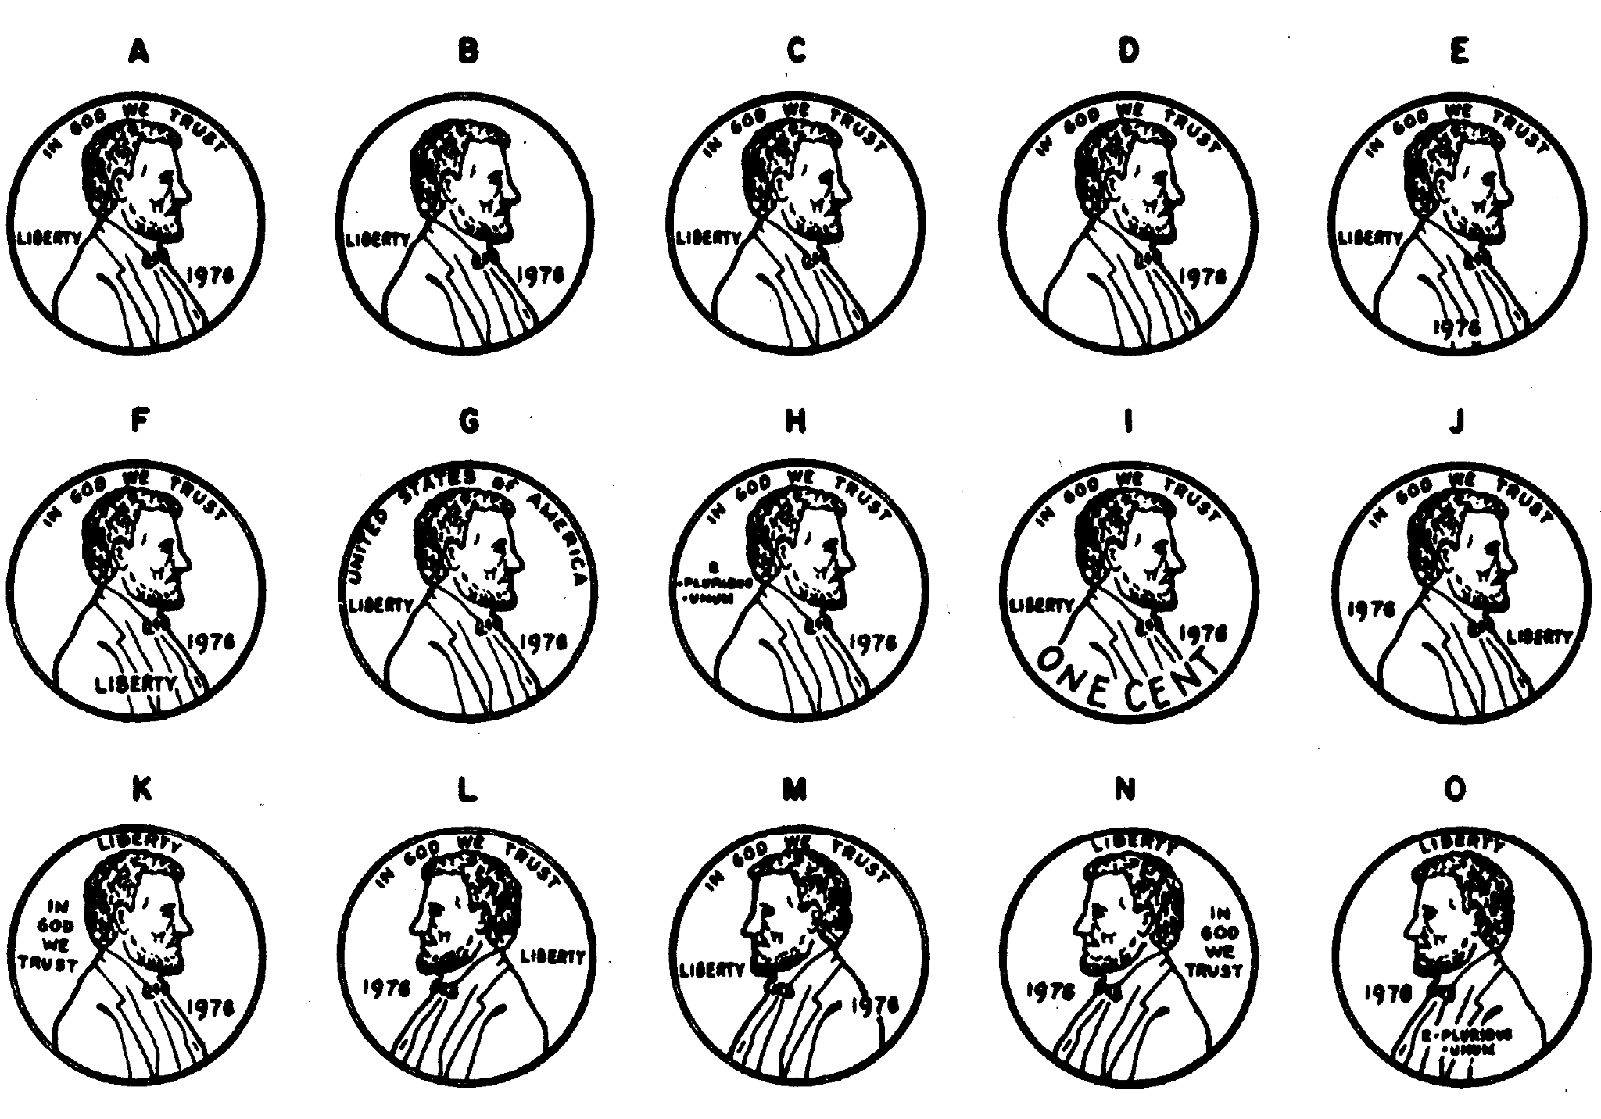

Slide 191
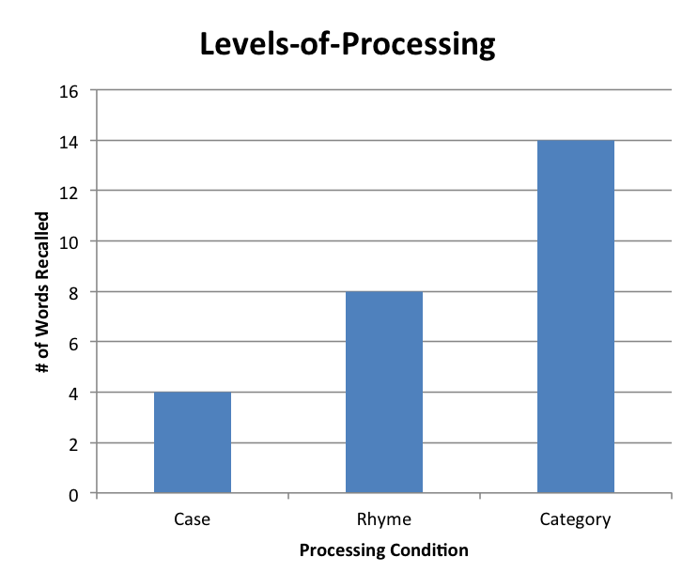
Results
When you are finished, give your totals to the experimenter. When they are all together, calculate the average number of “Case” words, “Rhyme” words, and “Category” words that were recalled.
You will likely find that recall for “Case” words was lowest, recall for “Rhyme” words was higher, and recall was highest for “Category” words.

Slide 192
Debrief
This experiment is a replication of Craik and Tulving, 1975. It is commonly called the Levels-of-Processing effect. It shows that the way material is initially processed affects how easy it is to subsequently recall. Their original results (and many replications since) demonstrate that words are easiest to recall when they are processed in terms of their meaning. Processing words in terms of their phonology, or sound, is less conducive to later recall, and processing words in terms of their surface characteristics, such as whether the letters were uppercase or lowercase, are not effective at producing later recall.

